Slide 1
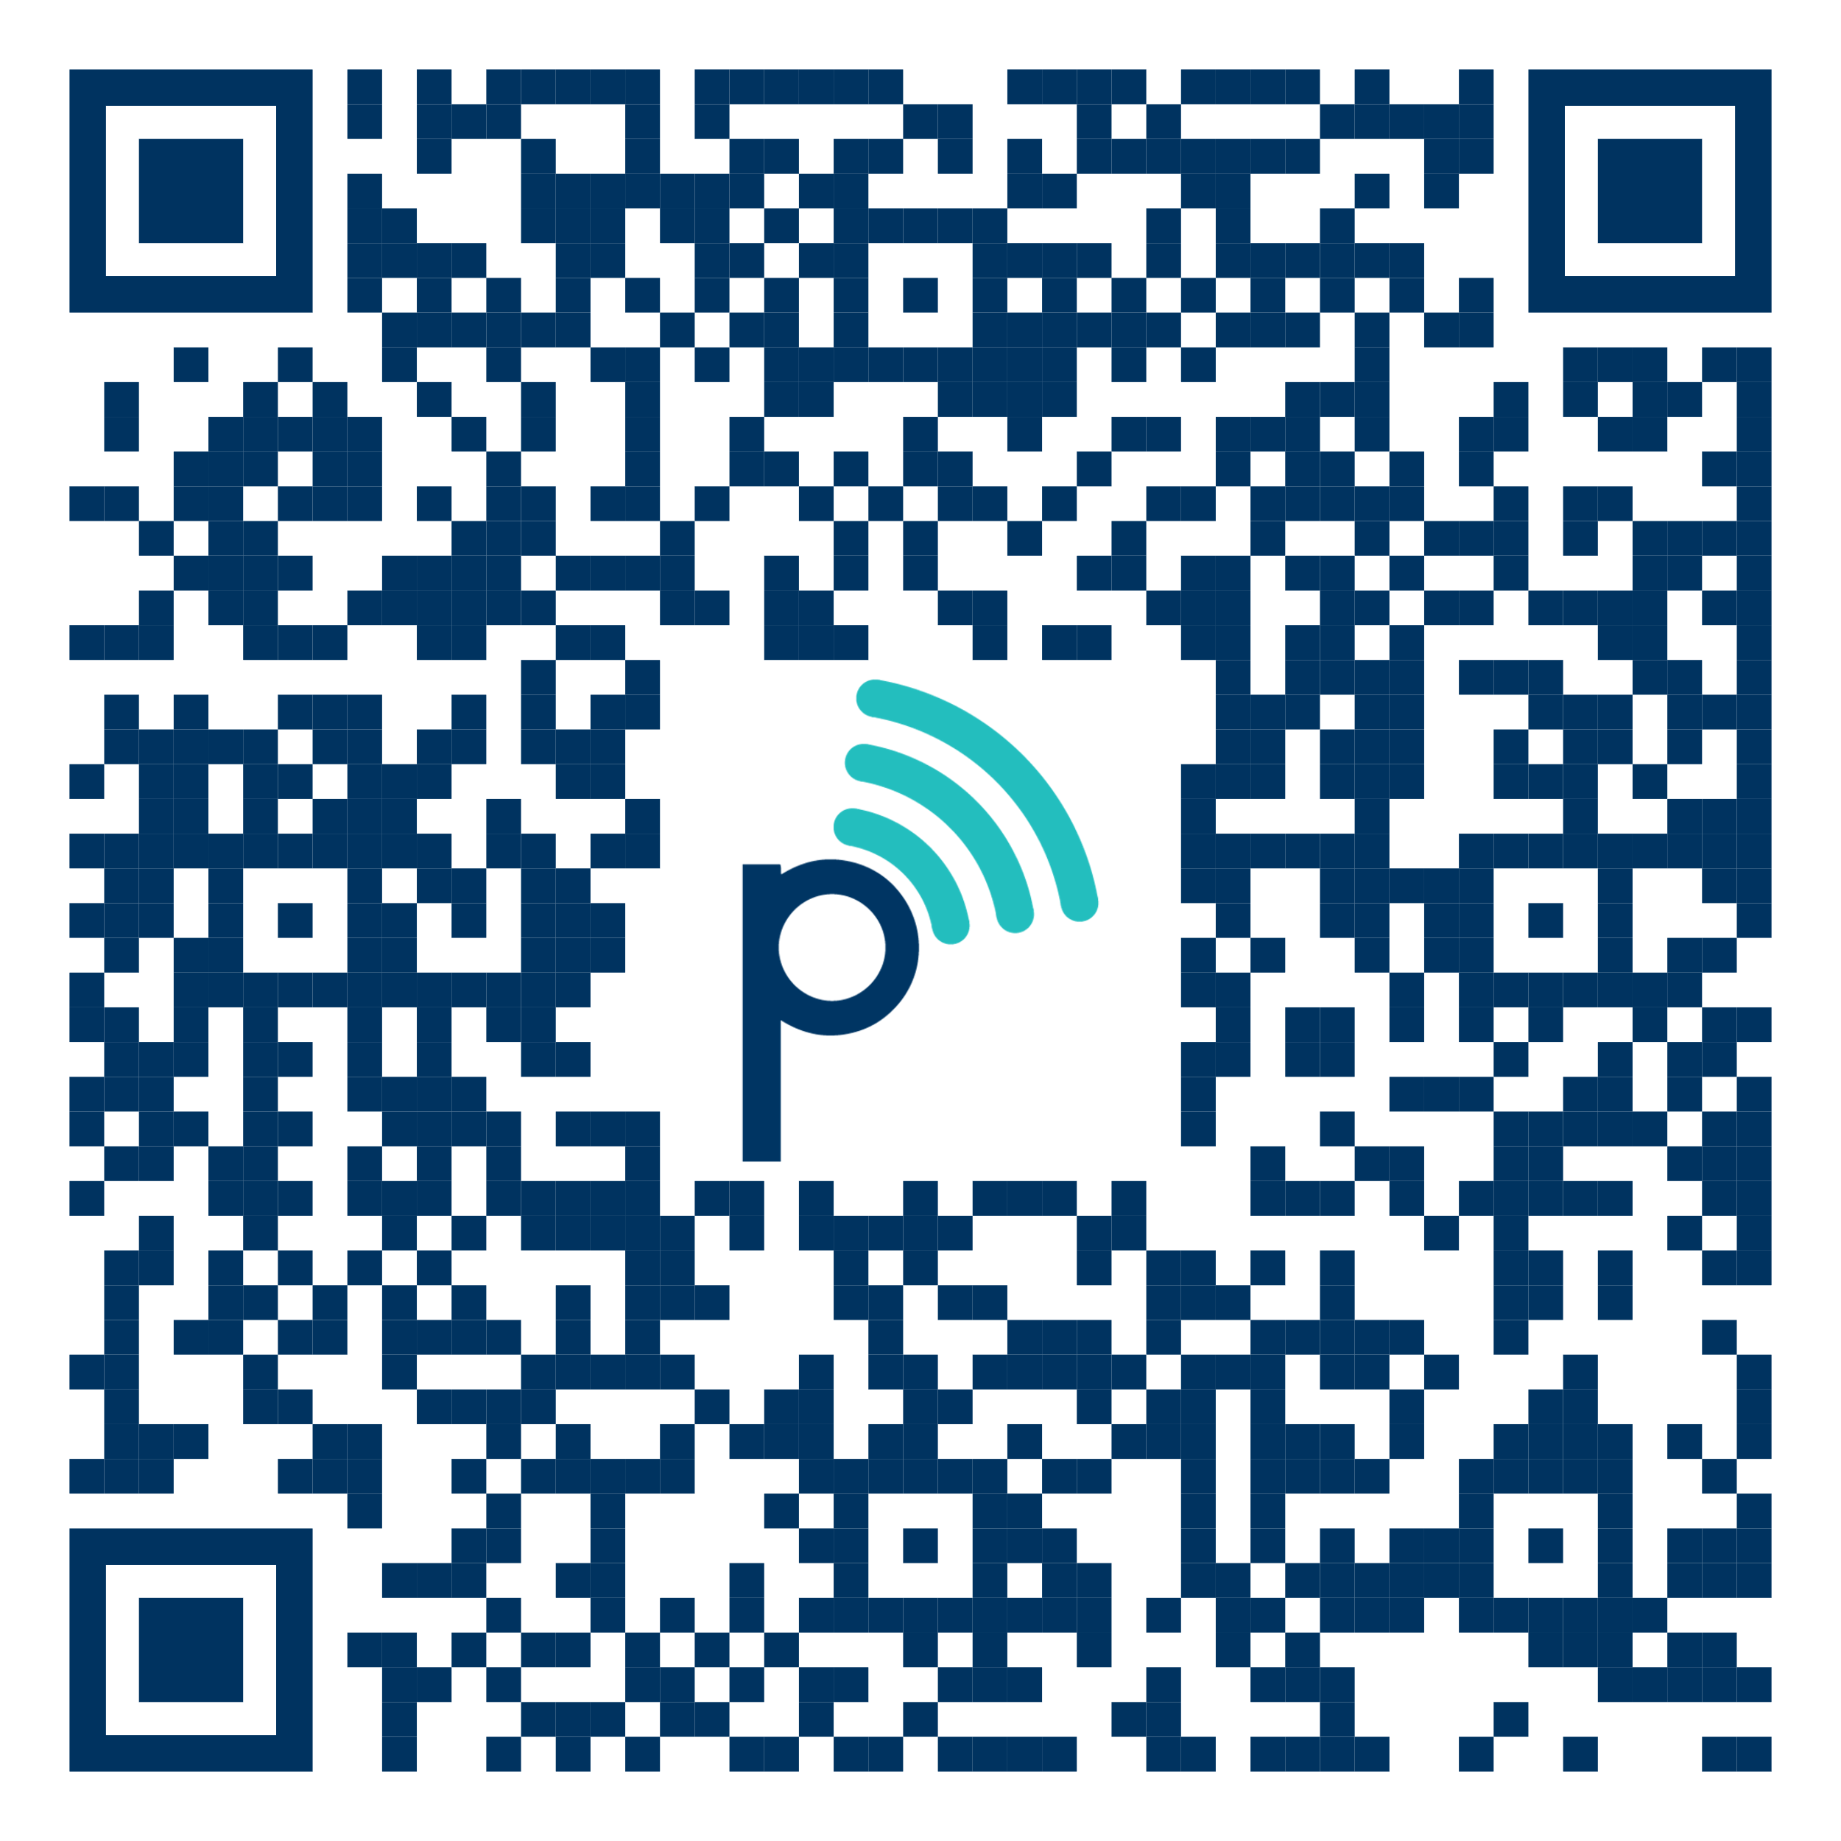
NilsPod & PortabilesDemoApp Tutorial
Luca Abel, Janis Zenkner
Ferienakademie Sarntal 2019

Slide 2
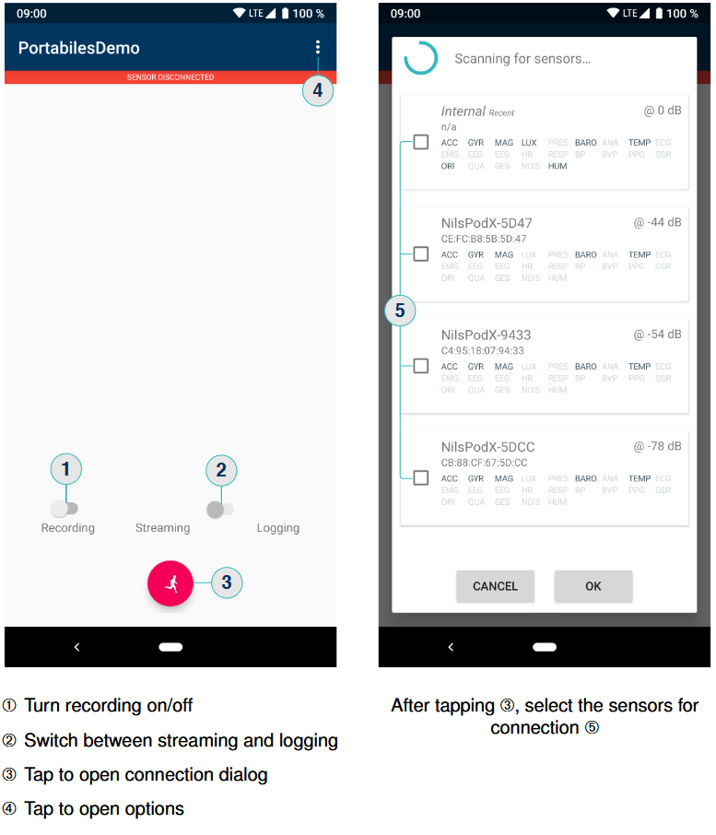
PortabilesDemoApp

Slide 3
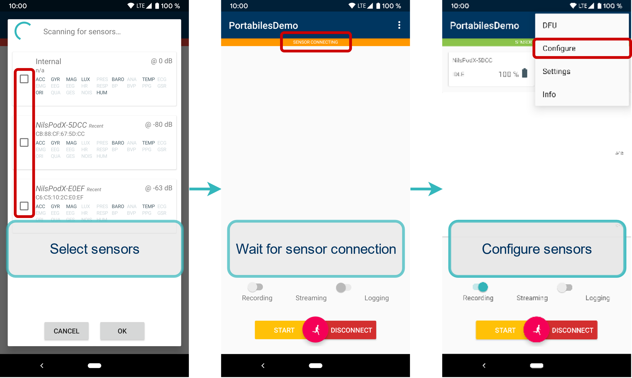
Streaming

Slide 4
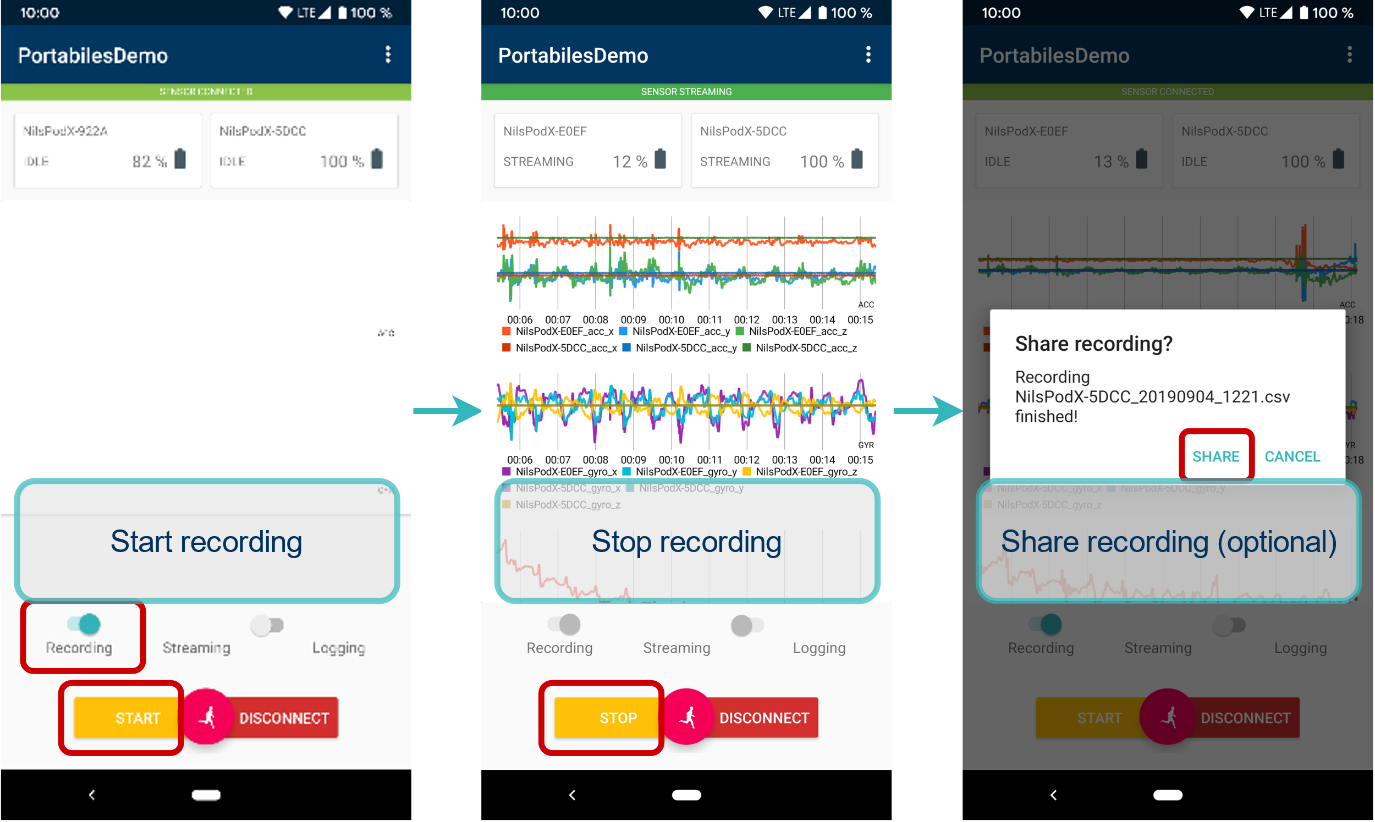
Streaming

Slide 5
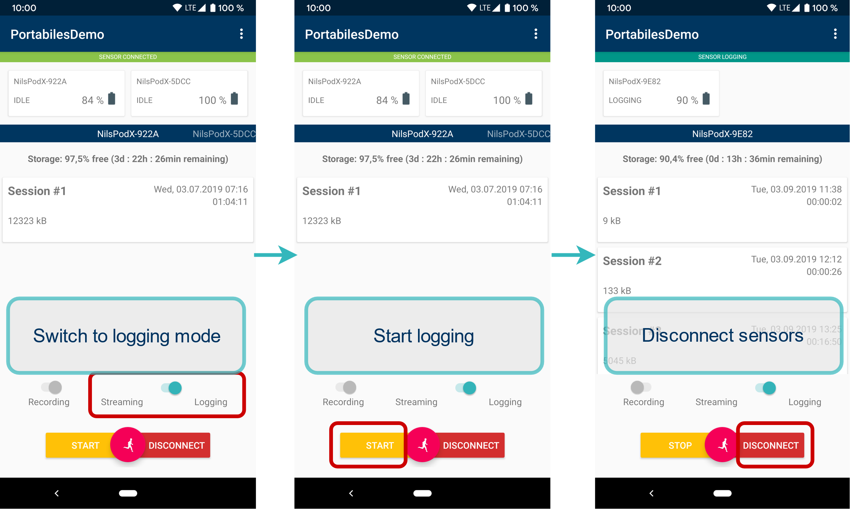
Logging

Slide 6
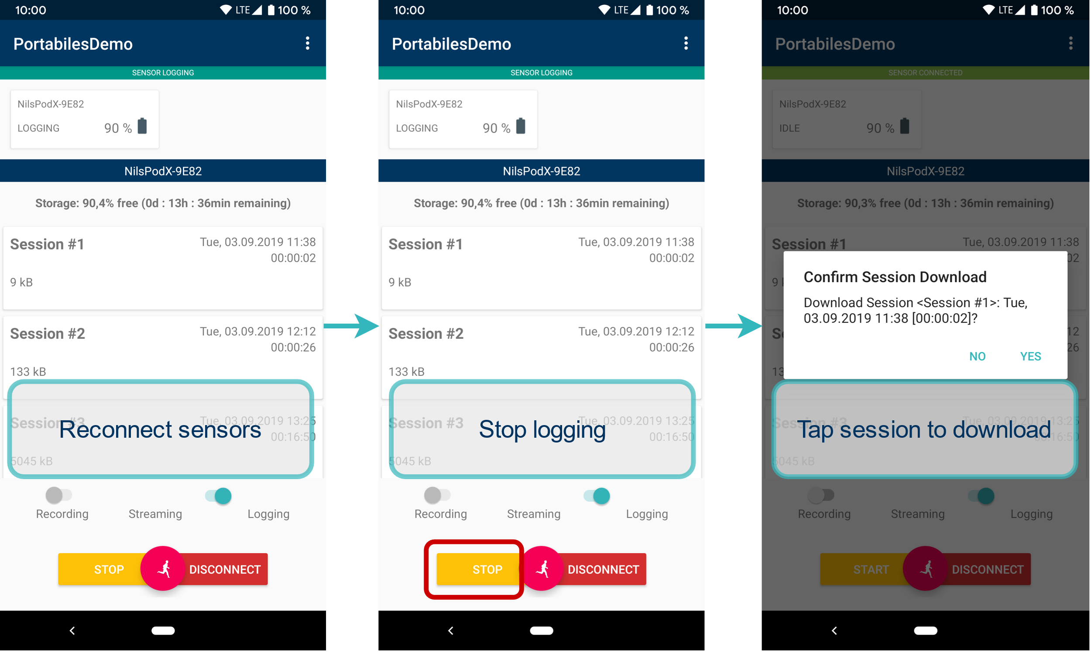
Logging

Slide 7
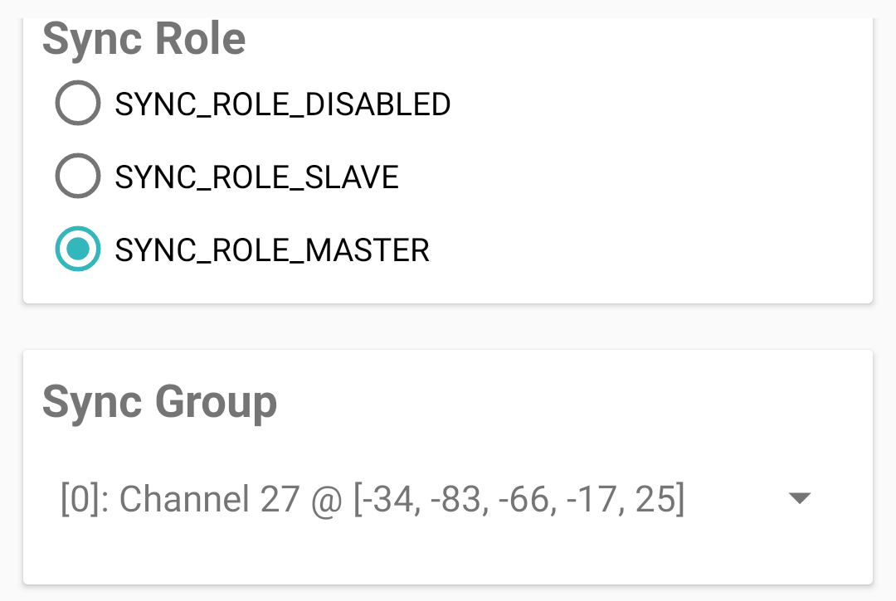
Synced Session
Set sync role (at least one master and one slave per group)
Make sure sensors are assigned to the same sync group
Synced sessions only work in logging mode!

